Slide 1
Battle of the Neighborhoods – A Case Study of African Restaurants and Cuisines in New York City
Fidelis Ifeanyi Ariguzo
09/03/2020

Slide 2
Agenda
Project Description/ Background
Project Goal and Significance
Data Description
Methodology
Result and Discussion
Conclusion and Recommendation

Slide 3
Project Description and Background
8.3 million people reside in New York City (NYC).
25.1% are either African Americans and/or have migrated from Africa
Hospitality industry thrives in NYC because of the population and diversity of residents.
NYC is a center of attraction for tourism and business purposes.

Slide 4
Project Goal and Significance
Evaluate the boroughs in NYC and determine which would favor the opening of an African restaurant.
Project will be suitable for small-scale culinary investors.
Study is suitable for people looking to start African catering business where there is little to no competition.

Slide 5
Data Description
New York json data file was used.
Geographical coordinates and maps of NYC and selection boroughs were conducted.
Data include neighborhood, borough, latitude, longitude, venues, venues category.
Foursquare API credentials used explore the neighborhoods within the selected boroughs.

Slide 6
Methodology
Step 1: Import Libraries
Step 2: Import and Arrange Data
Step 3: Geographical Exploration of New York City
Step 4: Geographical Exploration of Three New York Boroughs
Step 5: Using Foursquare API to Explore the Boroughs
Step 6 : Explore Neighborhoods in Manhattan, Brooklyn, and Queens

Slide 7
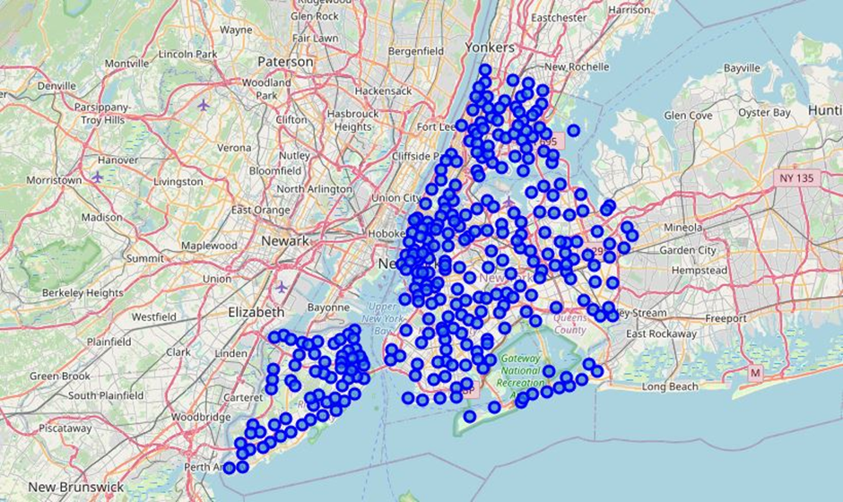
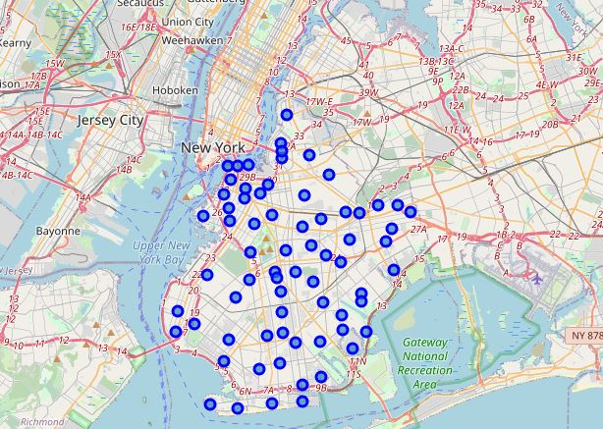
Results and Discussions
Map of New York City
Map of Brooklyn

Slide 8
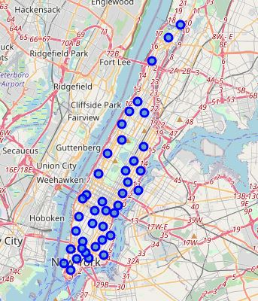
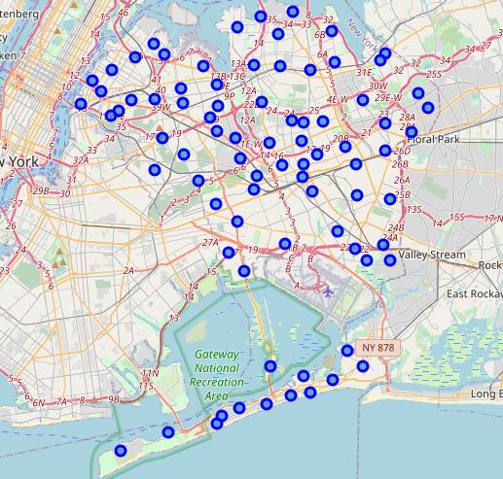
Results and Discussions
Map of Manhattan
Map of Queens

Slide 9
Results and Discussions
In Manhattan, there are 3 African restaurants all in the Central Harlem neighborhood.
In Brooklyn, there is only 1 African restaurant in Ocean Hill neighbourhood.
In Queens, there are no African restaurants on record. Thus, it will be a good location.

Slide 10
Result and Discussion
Manhattan is the biggest commercial borough.
Queens has the largest land mass (108.1sqmi) followed by Brooklyn (69.5sq mi).
The two busiest airports in NYC are in Queens.
2 &1 out of every 5 residents in NYC live in Brooklyn and Queens respectively.
The target borough audience for opening a new African restaurant is in Queens and Brooklyn.
This rule out the competition challenge and repetition of restaurant types and cuisines.

Slide 11
Conclusion and Recommendation
NYC data was evaluated to determine the most suitable borough for opening an African restaurant.
Several python libraries and methods were used.
Foursquare API credentials were also used to investigate the neighborhoods.
Queens borough appears to be the most suitable borough for locating the proposed African restaurant.
This work can be extended to the remaining two boroughs.

